Slide 1
3D Web Game Odyssey Shooter
Mamud Rostam

Slide 2
Task
To create and present a 3D web game and website using HTML, CSS and JS.

Slide 3
Game Type and Description
Type: Shooting game
Description: The player will have control of a ship that can shoot and incoming projectiles, there will be a timer and score system. The player will need to doge the incoming asteroids (cubes for now)that will do damage to the player when they get hit by them, the player will also be able to shoot at other obstacles that increases their score.

Slide 4
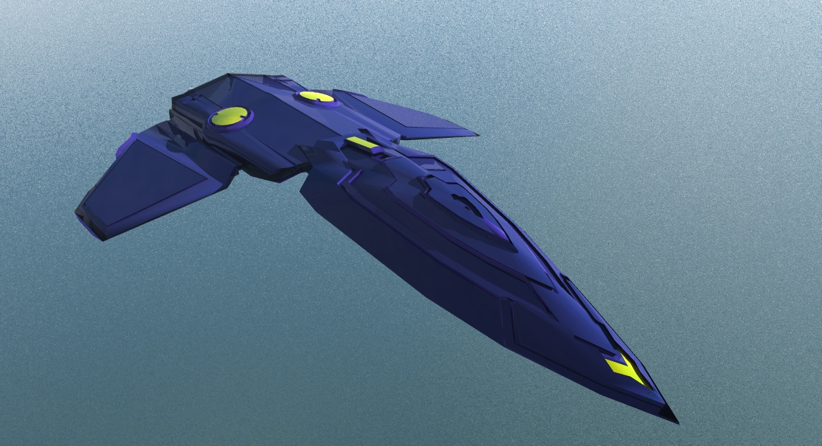

Assets
A.) Player
B.) skybox

Slide 5
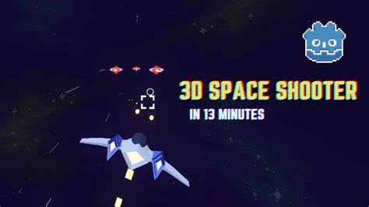
Image examples
A.) Example of what my web game will look like

Slide 6
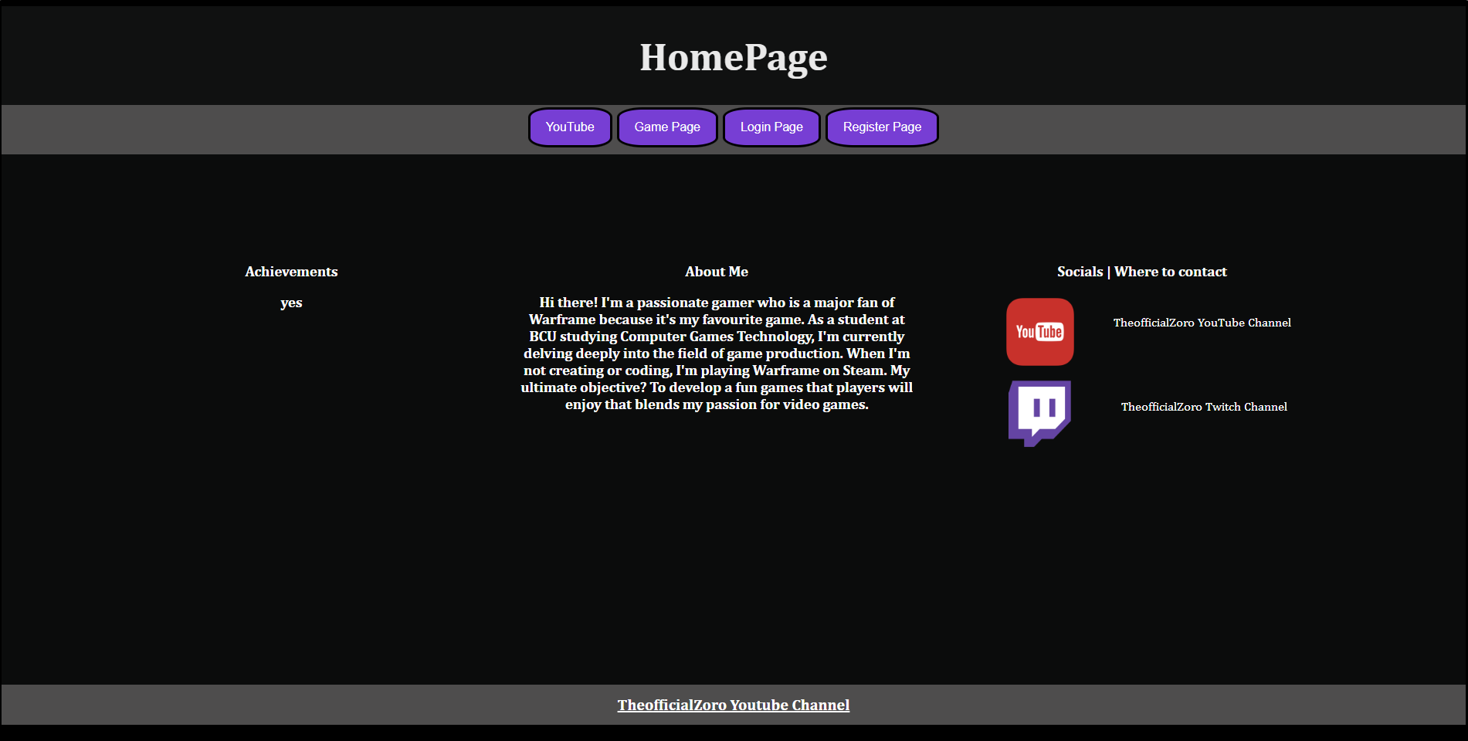
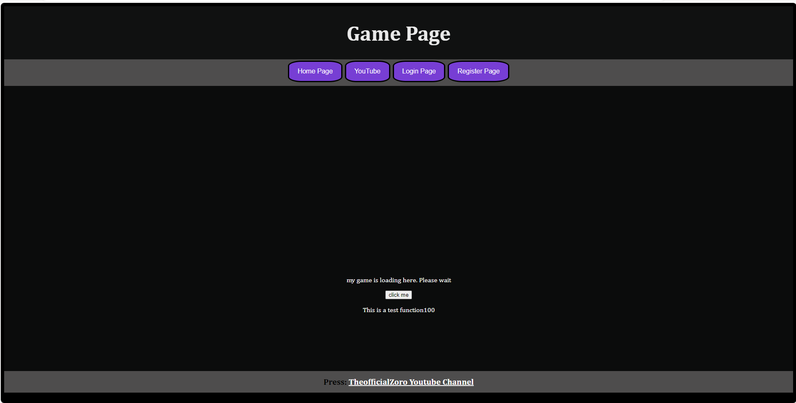
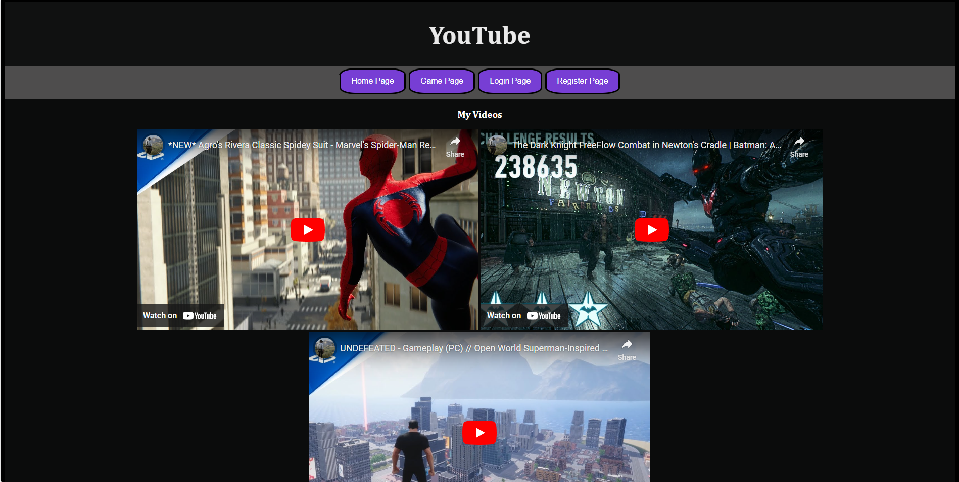
Web preview

Slide 7
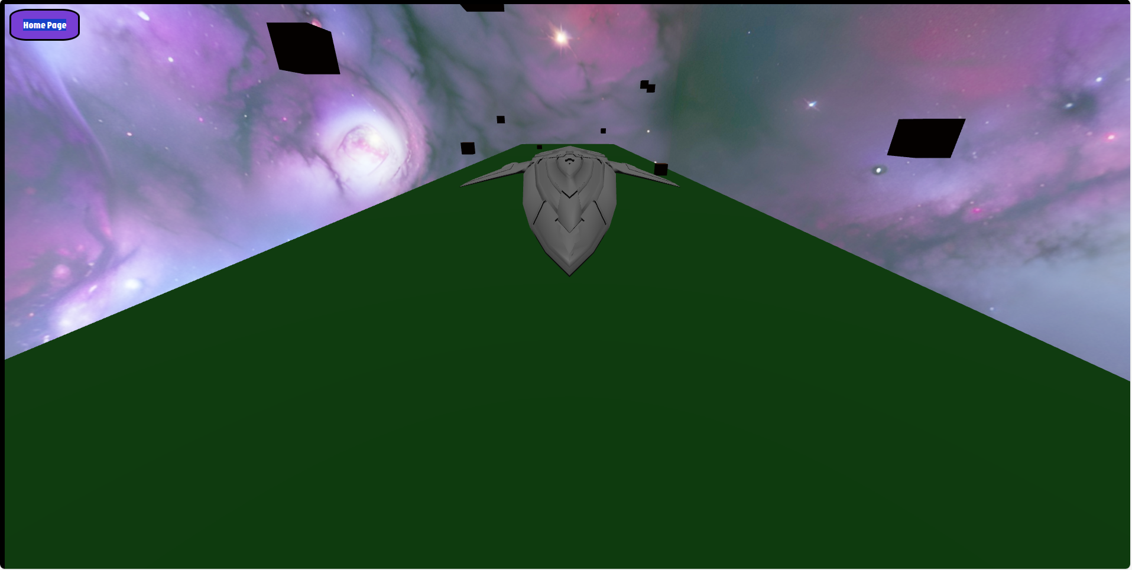
Game preview
A. Image of what my game looks like

Slide 8
Controls
WASD to move around and use the mouse left click to shoot

Slide 9
What to do
Add the server to my game
Add health to my player
Add a score system
Improved shooting

Slide 10
Refrences
Model – Aircraft Free 3D Models download - Free3D
Background – Newsfeed - Sketchfab
W3schools – W3Schools Online Web Tutorials
Javascript codes - Three.js – JavaScript 3D Library

Slide 11
Any questions

